Slide 1
Magic Square
CS315 – Group: 6670
Semester: 471
Saif Alotaibi 441108631
Omar Alsuhibani 441108502
Mohammed Alrouji 441109006
Abdulrahman Alghanayam 441109766
Mohammed Alsuhaibani 441108783
Supervisor: Prof. Dr. Mohammed Al-Hagery

Slide 2
What is a magic square?
1- Square matrix
2- The sums of each row, column &
diagonal equals the same constant
3- Its order must be greater than 2
4- it must contain only numbers 1 through the square of the order
without duplicates

Slide 3
Problem
Construction changes based on the order
If its odd, we’ll implement the Siamese Method
If its evenly-even, we’ll implement the Exchange Method
If it’s oddly-even, we’ll implement the Strachey Method

Slide 4
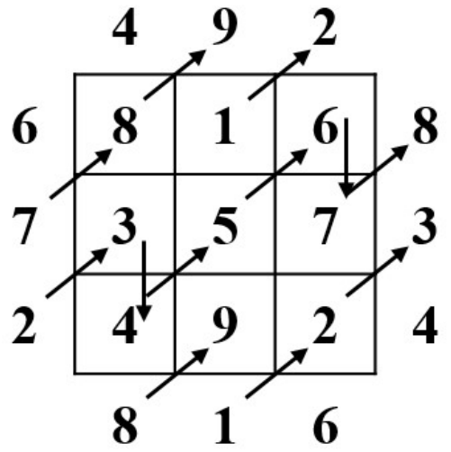
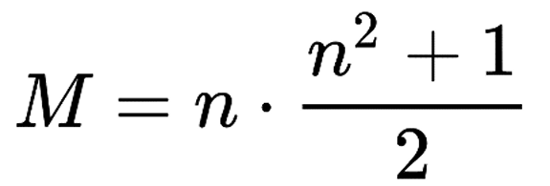
Siamese Method:
This is the simplest Siamese example , where n = 3 :
Always starts from first row in column n/2 (3/2)
Size of matrix is n*n (3*3)
Maximum diagonal move is n (3)
Sum of any row or column is M

Slide 5
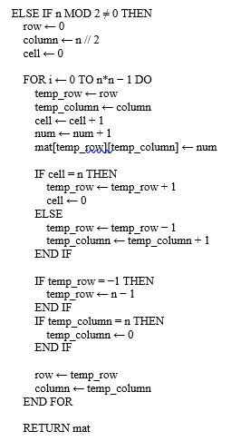



Naïve Pseudocode
Total number of operations
$$21n^{2}+ 9$$
Time complexity
$O(n^{2})$
Space Complexity
$O(n^{2})$

Slide 6
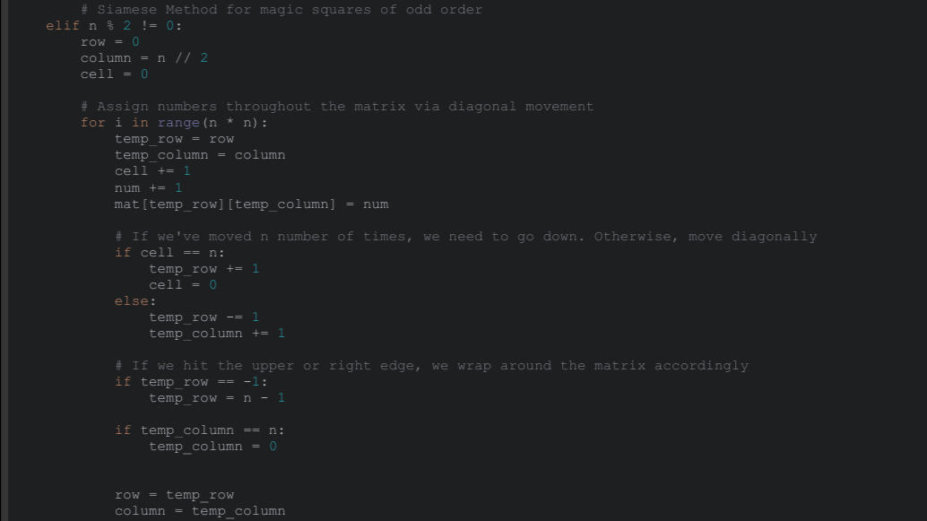
Naïve Implementation

Slide 7
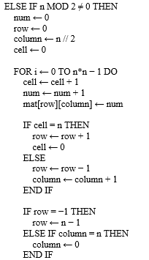



Optimized Pseudocode
Total number of operations
$$15n^{2} + 9$$
Time complexity
$O(n^{2})$
Space Complexity
$O(n^{2})$

Slide 8
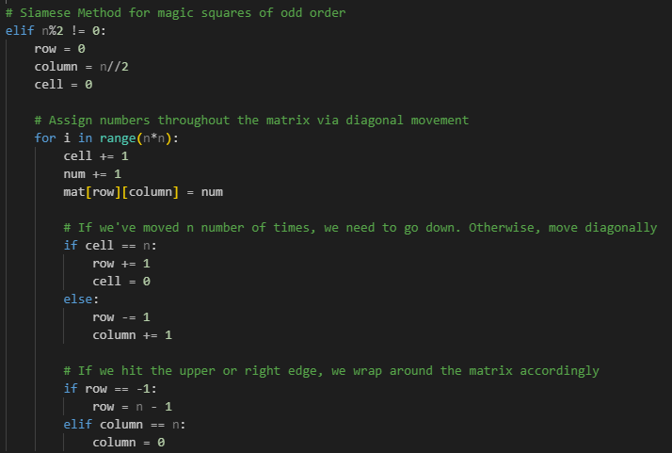
Optimized implementation

Slide 9
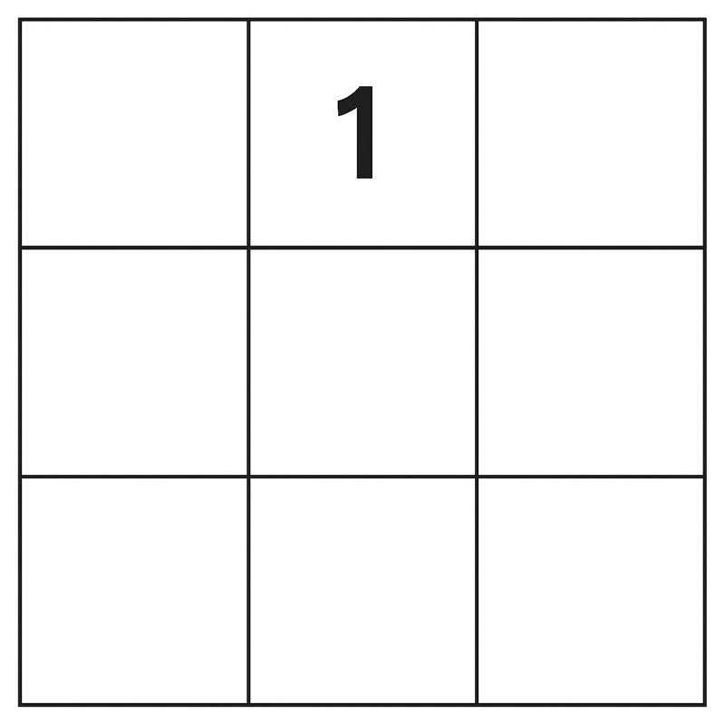
Output example
8
6
3
5
7
4
9
2

Slide 10
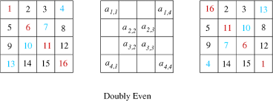
Exchange method

Slide 11
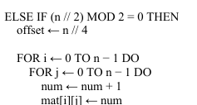

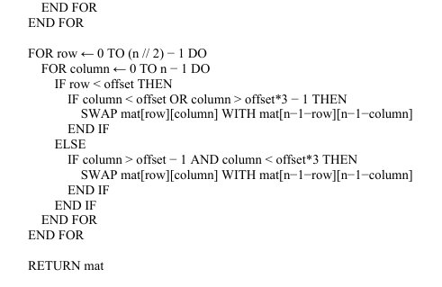
Naïve pseudocode

Slide 12
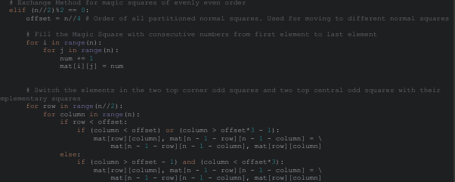
Naïve implementation

Slide 13
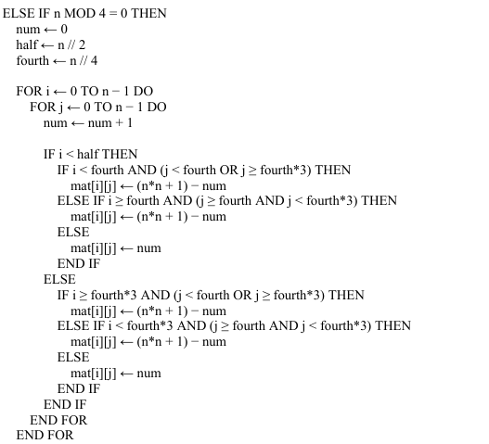


Optimized pseudocode

Slide 14
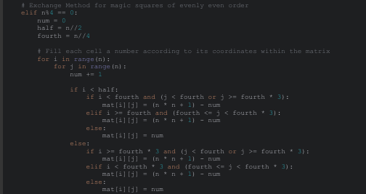
Optimized implementation

Slide 15
Output example

Slide 16
Strachey Method
When the order is oddly-even (6, 10, 14...)
Partition the square matrix into four matrices
Perform the Siamese method on each matrix in a certain order
Swap certain elements

Slide 17
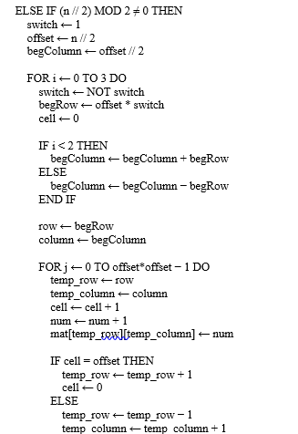
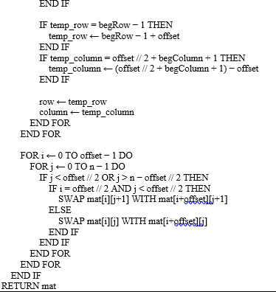

Naïve pseudocode
Total number of operations
$$42n^{2}+n+60$$
Time complexity
$O(n^{2})$
Space Complexity
$O(n^{2})$

Slide 18

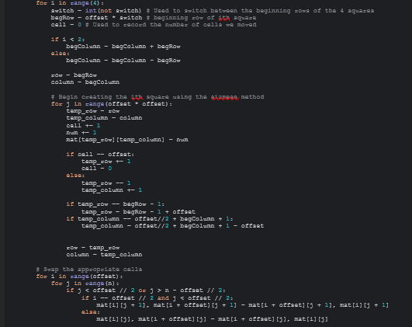
Naïve Implementation

Slide 19
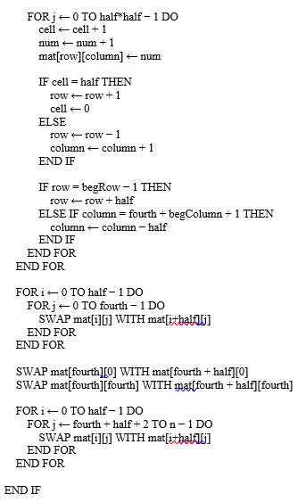
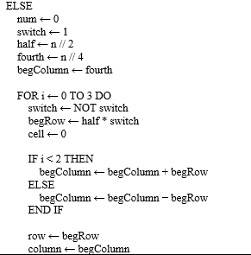
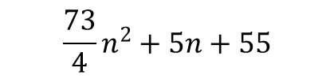
Optimized Pseudocode
Total number of operations
$$\frac{73}{4}n^{2}+5n+55$$
Time complexity
$O(n^{2})$
Space Complexity
$O(n^{2})$

Slide 20
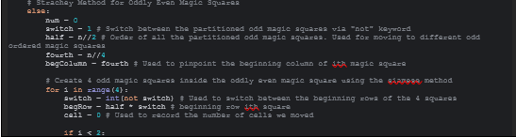
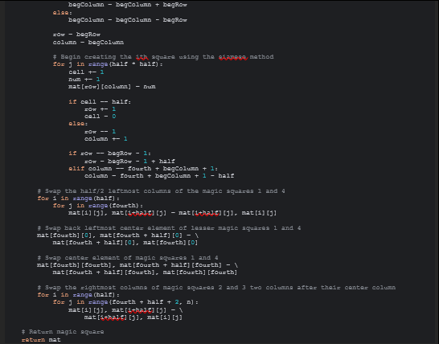
Optimized Implementation

Slide 21
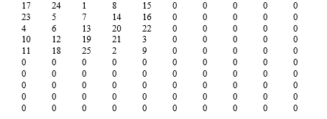
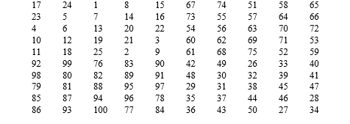
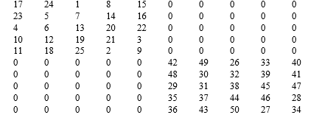
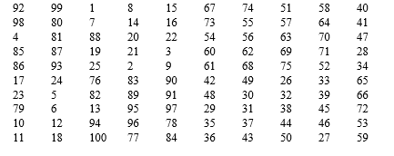
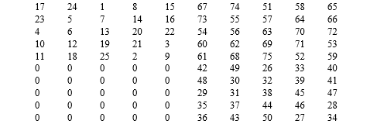
Example Output

Slide 22
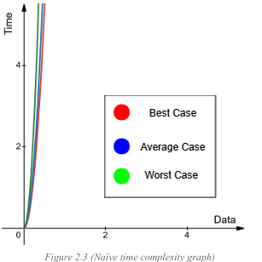


Naïve scenarios
Best case: Siamese method
Average case:since n can be odd, evenly-even or oddly even
Worst case: starchy method
In all cases the space complexity is o(𝑛^2)

Slide 23
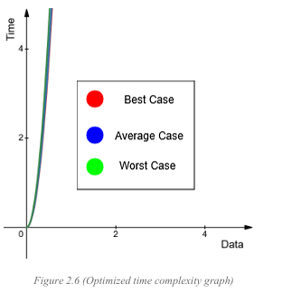



Optimized scenarios
Best case: Siamese method
Average case:since n can be odd, evenly-even or oddly even
Worst case: starchy method
In all cases the space complexity is o(𝑛^2)

Slide 24
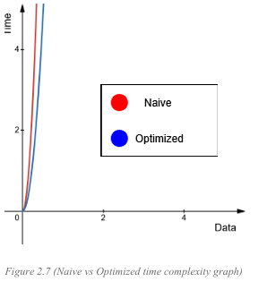
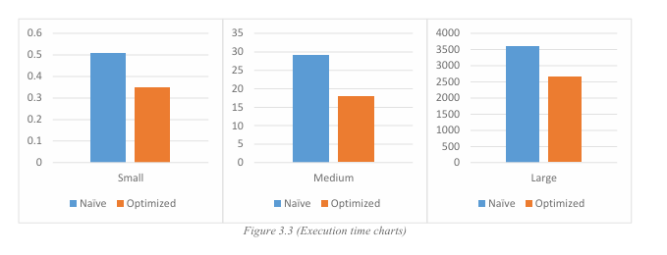
Scenarios comparison

Slide 25
conclusion
Our empirical analysis shows the optimized algorithm creates a magic square faster than the naïve one, demonstrating that reducing operations can improve efficiency even without better time complexity.

Slide 26
Thank you

